Slide 1
WINE
陈正，胡祺，文睿琦

Slide 2
History of wine
01

Slide 3
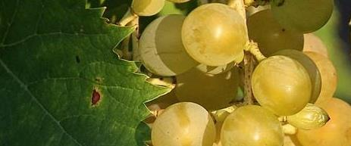
Ancient Origins (6000 BC – 500 BC)
Caucasus(高加索）
Egypt
Ancient Greece
Modern Georgia(格鲁吉亚), Armenia(亚美尼亚) and Iran are considered the origins of wine.
Archaeological discoveries have detected wine composition in the remains of clay pots dating back to 6000 BC
The murals in the tombs of the Egyptian pharaohs show the process of viticulture and winemaking, wine as a religious ritual and a noble drink.
Wine became central to Greek culture and was closely linked to the cult of Dionysus（酒神）
The Greeks improved their winemaking techniques and broadened viticulture to the coast (e.g., Italy, southern France).

Slide 4
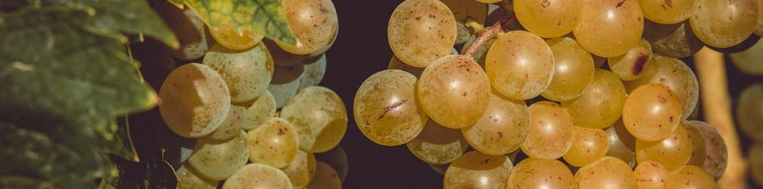
OfficePLUS POWERPOINT
Golden Age of the Roman Empire
(500 BC – 500 AD)
The Romans perfected viticulture (such as grafting techniques), oak barrel aging, and established systematic vineyard management. Therefore, viticulture was introduced to France, Spain, and Germany, laying the foundation for the European wine map.
At the same time, wine is used in the Christian ritual, giving it a sacred meaning in order to remember the sacrifice of Christ

Slide 5
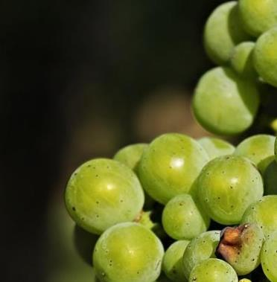
OfficePLUS POWERPOINT
Globalization of Great Navigation (15th – 18th centuries)
Modern Crisis and Revival (19th – 20th centuries)
Spanish missionaries brought grapes to the Americas, and the Dutch ，planted grapes in South Africa, beginning the history of wine in the New World.
In 1863, phylloxera（根瘤蚜虫）was introduced to Europe from the Americas, destroying 90% of vineyards, which was eventually solved by grafting American rootstocks.
Australia, California, Chile and other regions have used industrial production and technological innovation to challenge Europe's traditional position.

Slide 6
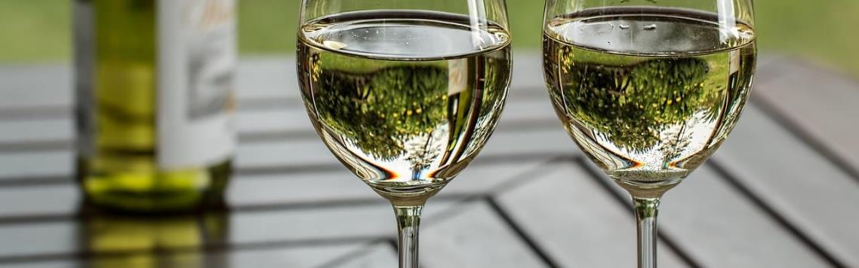
Modern Diversification (Late 20th – 21st Century)
Scientific winemaking: temperature-controlled fermentation, stainless steel barrels, and microbiological research to improve quality stability.
New Style Exploration: The Rise of Garage Wine and Natural Wine

Slide 7
Wine Manufacturing Process
02

Slide 8
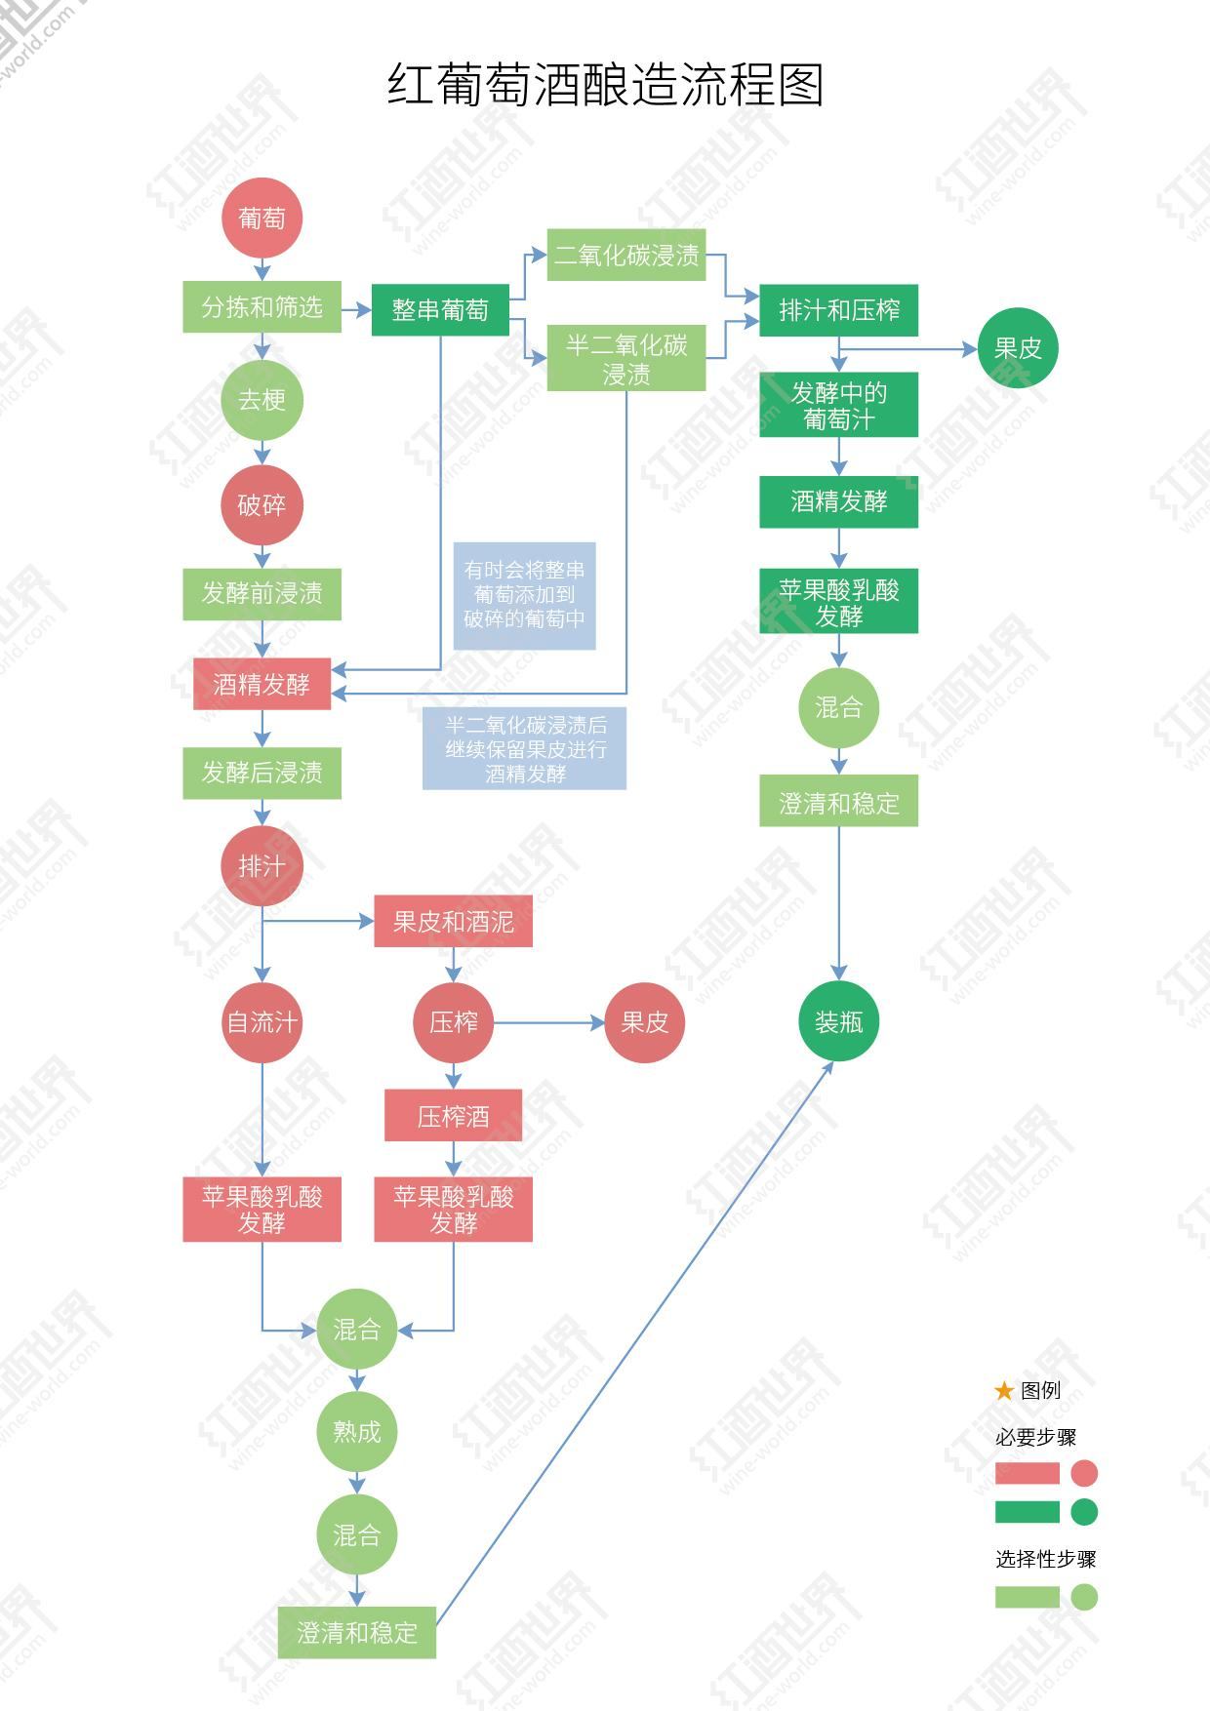
5 steps from grapes to wine
The Harvest
Crush and Pressing
Fermentation
Clarification
Aging and Bottling
Reference:
[1]Wine world , zhuanlan.zhihu.com/p/108279979# , 2020.2.21
[2] www.winemonthclub.com/the-wine-making-process

Slide 9
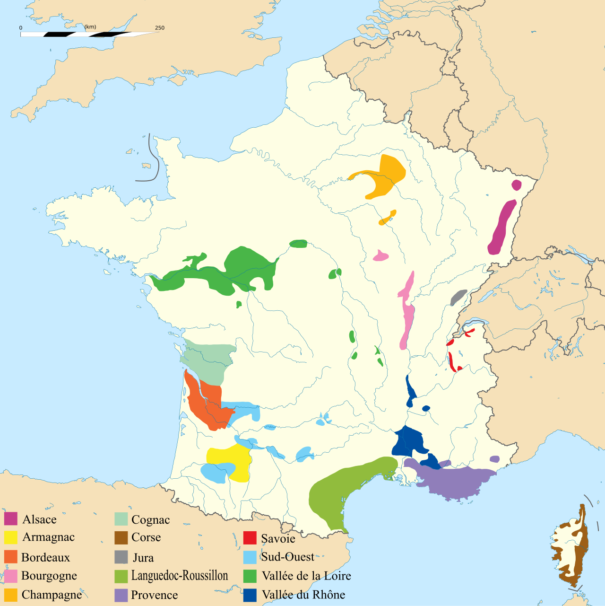
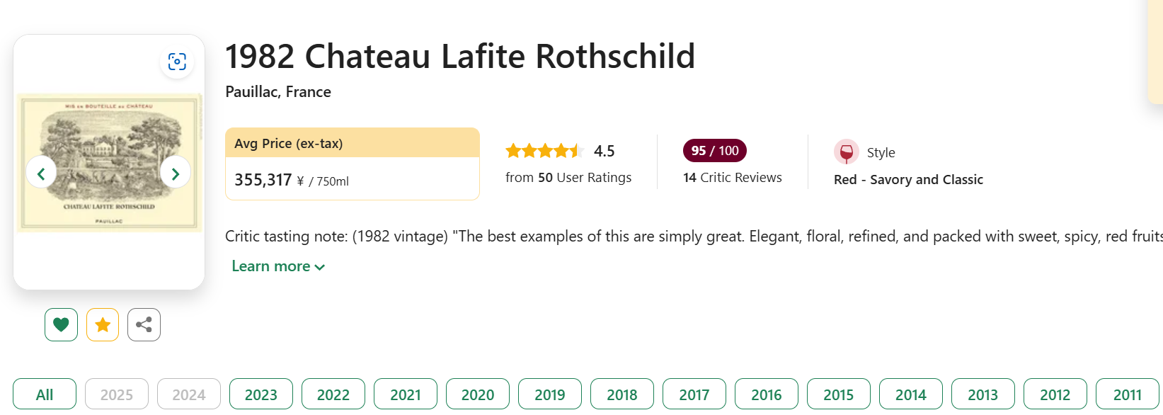
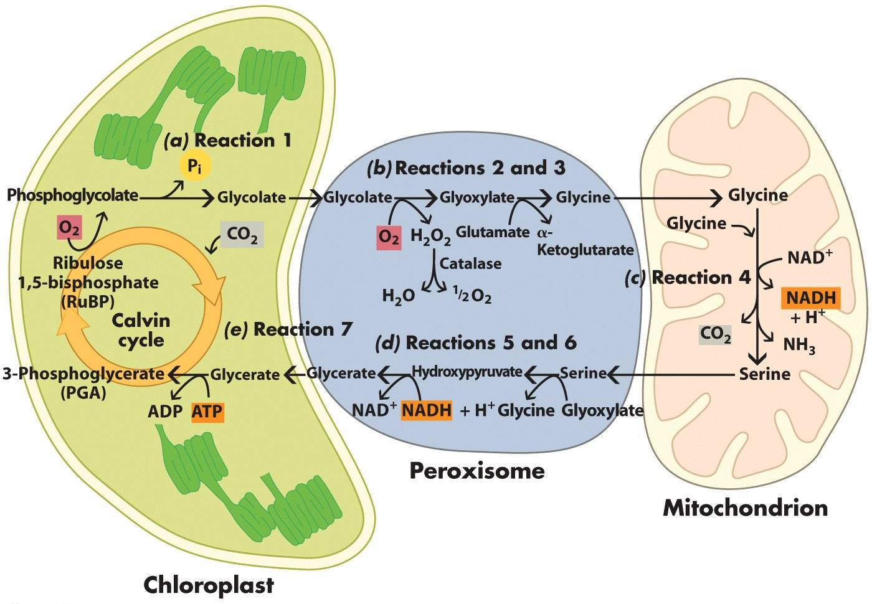
The Harvest : Why does 1982 Lafite hit the headline ?
Photosynthesis
Respiration
Reference:
[1] Archimatth - File:Vignobles_France.svg，CC BY-SA 2.5，https://commons.wikimedia.org/w/index.php?curid=37093378
Notes:
Harvesting or picking is certainly the first step in the actual wine making process. Without fruit there would be no wine, and no fruit other than grapes can produce annually a reliable amount of sugar to yield sufficient alcohol to preserve the resulting beverage, nor have other fruits the requisite acids, esters and tannins to make natural, stable wine on a consistent basis. For this reason and a host more, most winemakers acknowledge that wine is made in the vineyard, at least figuratively. The process of making fine wine requires that the grapes are harvested at a precise time, preferably when physiologically ripe. A combination of science and old-fashioned tasting usually go into determining when to harvest, with consultants, winemakers, vineyard managers, and proprietors all having their say. Harvesting can be done mechanically or by hand. However, many estates prefer to hand harvest, as mechanical harvesters can often be too tough on the grapes and the vineyard. Once the grapes arrive at the winery, reputable winemakers will sort the grape bunches, culling out rotten or under-ripe fruit before crushing.

Slide 10
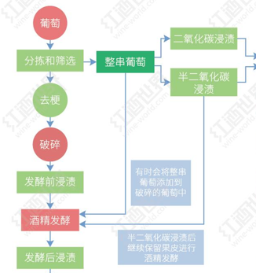
Crush and Pressing: Tech differs , favor varies .
Impregnation:
CO2 or half-CO2
The whole bunch of unbroken grapes is placed in a fermentation tank, and then carbon dioxide is injected to expel oxygen, triggering fermentation in the fruit. When the alcohol concentration in the fruit reaches 2%, the skin gradually cracks and the grape juice flows out.
Notes:
Crushing the whole clusters of fresh ripe grapes is traditionally the next step in the wine making process. Today, mechanical crushers perform the time-honored tradition of stomping or trodding the grapes into what is commonly referred to as must. For thousands of years, it was men and women who performed the harvest dance in barrels and presses that began grape juice's magical transformation from concentrated sunlight and water held together in clusters of fruit to the most healthful and mystical of all beverages - wine. As with anything in life, change involves something lost and something gained. By using mechanical presses, much of the romance and ritual has departed this stage of wine making, but one need not lament too long due to the immense sanitary gain that mechanical pressing brings to wine making. Mechanical pressing has also improved the quality and longevity of wine, while reducing the winemaker's need for preservatives. Having said all this, it is important to note that not all wine begins life in a crusher. Sometimes, winemakers choose to allow fermentation to begin inside uncrushed whole grape clusters, allowing the natural weight of the grapes and the onset of fermentation to burst the skins of the grapes before pressing the uncrushed clusters.
Up until crushing and pressing the steps for making white wine and red wine are essentially the same. However, if a winemaker is to make white wine, he or she will quickly press the must after crushing in order to separate the juice from the skins, seeds, and solids. By doing so unwanted color (which comes from the skin of the grape, not the juice) and tannins cannot leach into the white wine. Essentially, white wine is allowed very little skin contact, while red wine is left in contact with its skins to garner color, flavor, and additional tannins during fermentation, which of course is the next step.

Slide 11
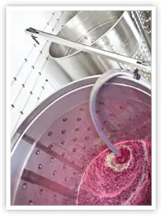
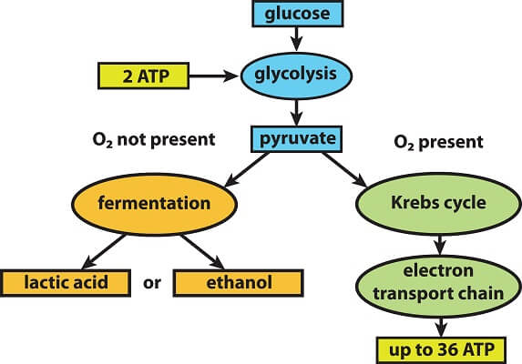
Fermentation: The Magic of Yeast
Reference:
[1] https://biologydictionary.net/wp-content/uploads/2021/01/1-4.jpg
Notes:
Fermentation is indeed the magic at play in the making of wine. If left to its own devices must or juice will begin fermenting naturally within 6-12 hours with the aid of wild yeasts in the air. In very clean, well-established wineries and vineyards this natural fermentation is a welcome phenomenon. However, for a variety of reasons, many winemakers prefer to intervene at this stage by inoculating the natural must. This means they will kill the wild and sometimes unpredictable natural yeasts and then introduce a strain of yeast of personal choosing in order to more readily predict the end result. Regardless of the chosen path, once fermentation begins, it normally continues until all of the sugar is converted to alcohol and a dry wine is produced. Fermentation can require anywhere from ten days to a month or more. The resulting level of alcohol in a wine will vary from one locale to the next, due to the total sugar content of the must. An alcohol level of 10% in cool climates versus a high of 15% in warmer areas is considered normal. Sweet wine is produced when the fermentation process stops before all of the sugar has been converted into alcohol. This is usually a conscious, intentional decision on the part of the winemaker.

Slide 12
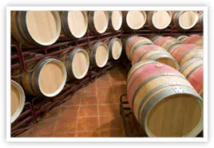
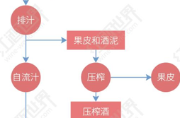
Clarification:
Notes:
Once fermentation is completed, the clarification process begins. Winemakers have the option of racking or siphoning their wines from one tank or barrel to the next in the hope of leaving the precipitates and solids called pomace in the bottom of the fermenting tank. Filtering and fining may also be done at this stage. Filtration can be done with everything from a course filter that catches only large solids to a sterile filter pad that strips wine of all life. Fining occurs when substances are added to a wine to clarify them. Often, winemakers will add egg whites, clay, or other compounds to wine that will help precipitate dead yeast cells and other solids out of a wine. These substances adhere to the unwanted solids and force them to the bottom of the tank. The clarified wine is then racked into another vessel, where it is ready for bottling or further aging.

Slide 13
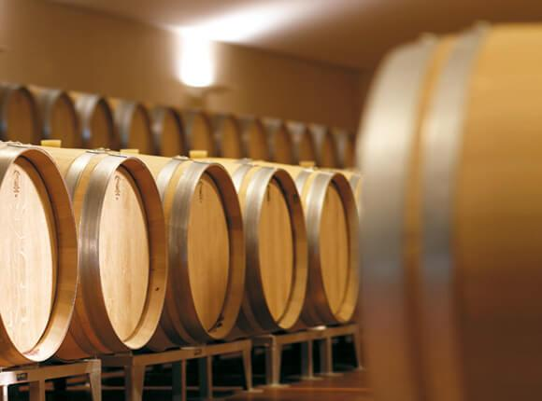
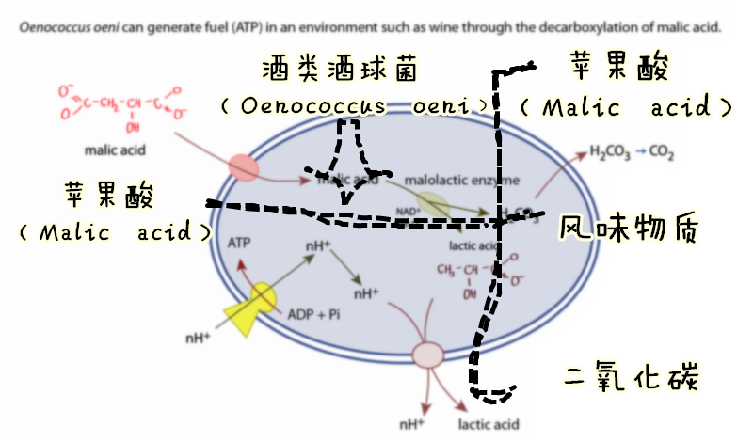
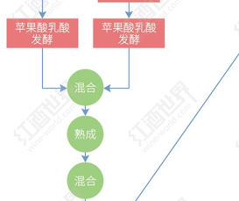
Aging and Bottling：Malic and lactic acid fermentation
Notes:
Almost all red wines need to undergo malolactic fermentation. This process can give red wine a smoother texture and richer aroma. During the wine aging process, winemakers and wineries will choose different containers for aging according to the wine style they want to achieve. For example, large neutral oak barrels can help the wine achieve a more subtle fusion, new oak barrels can give the wine a more complex flavor and structure, and stainless steel tanks can retain the fresh fruity aroma and flavor in the wine.

Slide 14
Brands

Slide 15
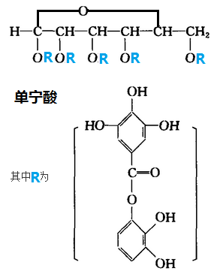
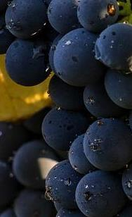
OfficePLUS POWERPOINT
01
02
Tannins单宁
Tastes
Tannins are natural polyphenolic compounds found in grape skins, seeds, and stems.
Main flavor: Dry, astringent
Intensity
Robust强劲/Soft
Eg. Sauvignon赤霞珠/ Merlot梅洛
Texture
Velvety天鹅绒/ Coarse生涩如砂纸(unripe)

Slide 16
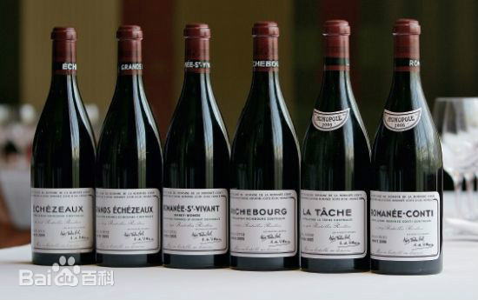
OfficePLUS POWERPOINT
Domaine de la Romanée-Conti(罗曼尼·康帝)
Quality Hallmarks:
5,000-bottle annual yield (3 vines/bottle)
Silken tannins丝绸质感单宁evolving from violet紫罗兰→ truffle松露
Technical Mastery:
18th-century manual grape treading (4 times /day)
Precision maceration control (tannin optimization)

Slide 17
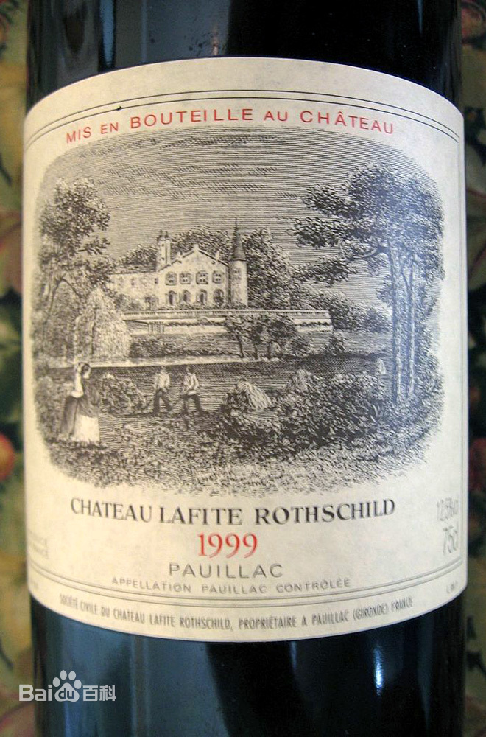
OfficePLUS POWERPOINT
Château Lafite Rothschild(拉菲)
Quality Hallmarks:
Cabernet Sauvignon-dominant blend赤霞珠混酿
20+ year aging potential陈年潜力(sandalwood/mineralogy balance檀木/矿物质平衡)
Technical Mastery:
Thermoregulated fermentation (28-30°C stainless steel)
Dual pump-over cycles双次淋皮技术(anthocyanin enhancement)

Slide 18
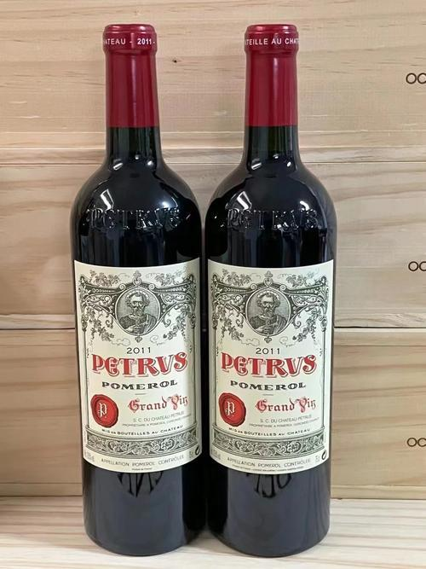
OfficePLUS POWERPOINT
Pétrus(帕图斯)
Quality Hallmarks:
100% Merlot梅洛"liquid velvet天鹅绒" texture
Dark chocolate & truffle松露
Technical Mastery:
Proprietary yeast + 28-day maceration浸渍
Oak chip micro-oxygenation

Slide 19
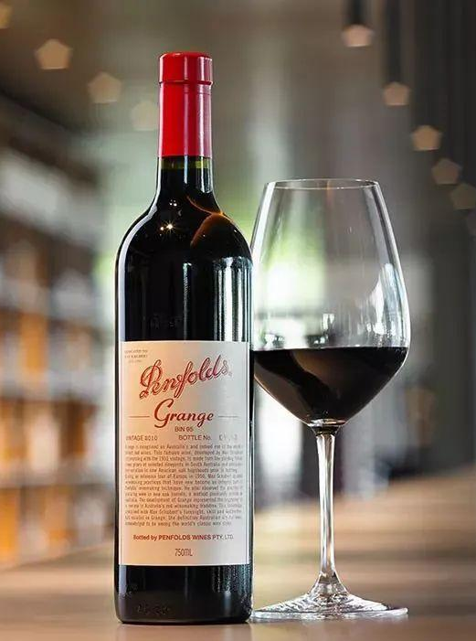
OfficePLUS POWERPOINT
Penfolds Grange(葛兰许)
Quality Hallmarks:
Multi-regional blend混酿innovation
American oak fermentation美桶发酵 (vanilla/coconut signature香草/椰奶调性)
Dual-strain yeast succession (EC1118 → RC212)
Glycosidase activation in oak橡木桶糖苷水解强

Slide 20
The secret to top wine quality is：
Using special grapes from specific places
Controlling the fermentation process very precisely
Mixing old and new winemaking techniques
Notes:
Using special grapes from specific places
This means using grapes that grow in unique areas, which give the wine its special taste.
Controlling the fermentation process very precisely
This is about carefully managing every step of making the wine, like temperature and how long the grapes soak, to ensure the best quality.
Mixing old and new winemaking techniques
This means combining traditional methods (like hand-pressing grapes) with modern technology (like using special yeasts) to make great wine.

Slide 21
Thank you for
watching.
Signature

